Slide 1

Secure Email Exchange
Elias renawi
Gazal khoury
Mahmoud ataria
Razy halabi

Slide 2

Serpent algorithm

Slide 3
Background
Was designed by Ross Anderson, Eli Biham and Lars Knudsen
01
It was first introduced in 1997
02
A Finalist in the Advanced Encryption Standard(AES) contest, got 2nd place after Rijndael algorithm
03

Slide 4

Description
Symmetric-key block cipher
Same key is used for encryption and decryption
Accepts key sizes of any length 128, 192, 256bit key lengths supported
Uses 8 different 4-bit S-boxes
Each S-box contains 16 elements
A total of 32 times
32 round block cipher
Works on fixed-length group of bits
Has a 128-bit block size
Broken into 4 of 32-bit words

Slide 5
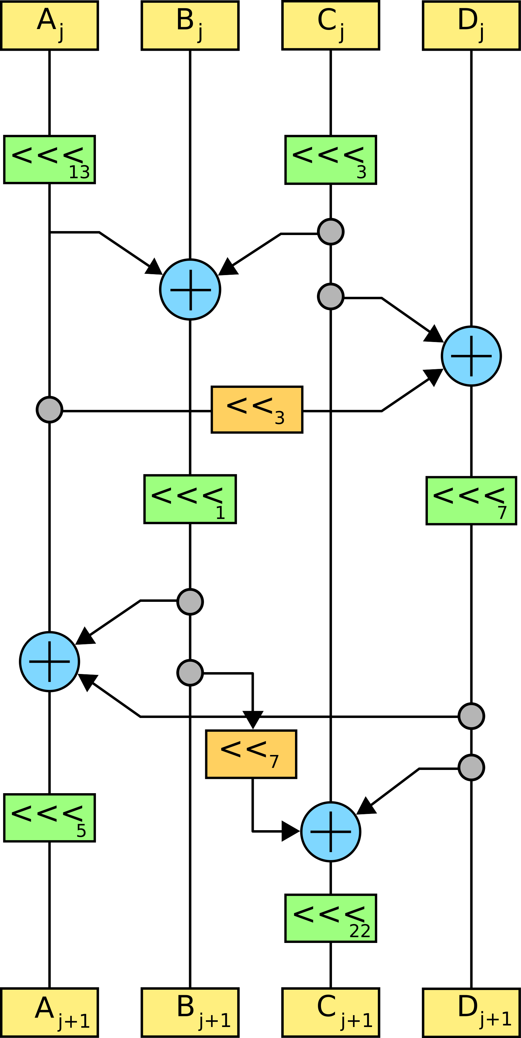
The cipher
An initial permutation IP
32 rounds of key mixing
A pass-through S-box and(in all but the last round ) linear transformation
In the last round the LT replaced by additional key mixing
A final permutation FP
The IP and FP don’t have any cryptographic significance
They are used to simplify an optimized implementation

Slide 6
Key Scheduling
The key scheduling algorithm of Serpent is defined for 256-bit keys
Shorter keys are padded by a single bit of 1 followed by as many bits of 0’s required to have a total length of 256 bits
Round keys are then generated by:
Recurrence operation with previous round keys (and the initial key at start)
A pass through one of the 8 S-boxes (starting with S3 and working down)

Slide 7
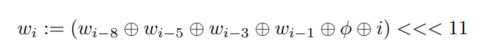
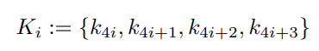
Subkeys
Making a 32 subkey for each round :
Our cipher requires 132 32-bit words of key material using the original 256 key
And through the following equation and through the S-box :
Φ is the golden ratio: 0x9e3779b9
And finally we append them together using the following equation

Slide 8
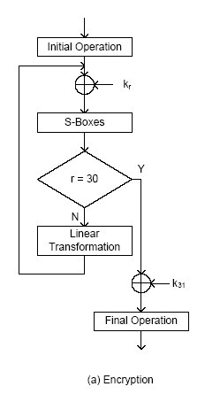
Encryption
S-boxes in each round are identical
Set of 8 unique S-boxes, each used 4 times
Linear Transformation on 4 32-bit words in parallel
Within 3 rounds, any change to input has affected every data bit

Slide 9
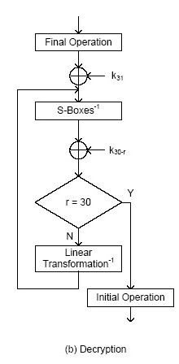
Decryption
Inverse the encryption process
Invert the linear transformation
Apply inverse S-boxes in reverse order
Note:
We didn't use the Serpent decryption method in our project
We did our decryption using OFB

Slide 10
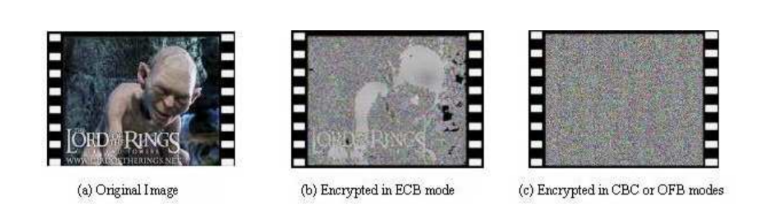
Output Feedback OFB

Slide 11

Introduction
Block Cipher Mode of Operation:
An algorithm that uses block cipher to provide information security
It is compounded of:
Block Cipher: which by itself is only suitable for the secure encryption or decryption of one fixed-length group of bits called a block
Mode of Operation: describes how to repeatedly apply a cipher's single-block operation to securely transform amounts of data larger than a block
OFB is one of these modes

Slide 12
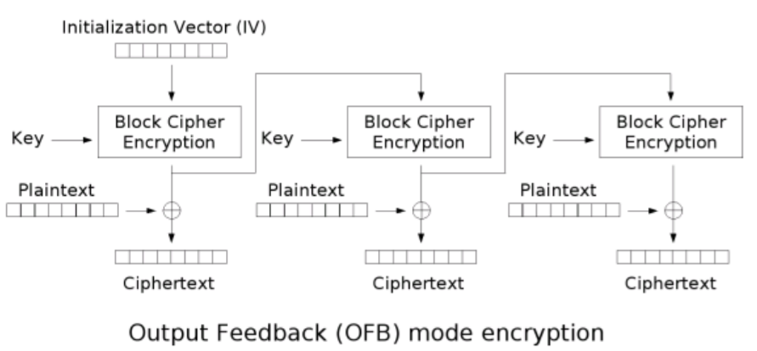
OFB Encryption
The first block cipher must have an initialization vector(IV).
Each block of plaintext is XOR-ed with the current output block to generate current ciphertext block.
Plaintext or ciphertext is not involved in the cipher function processing.
Notes:
The iv is random of 128 bit

Slide 13
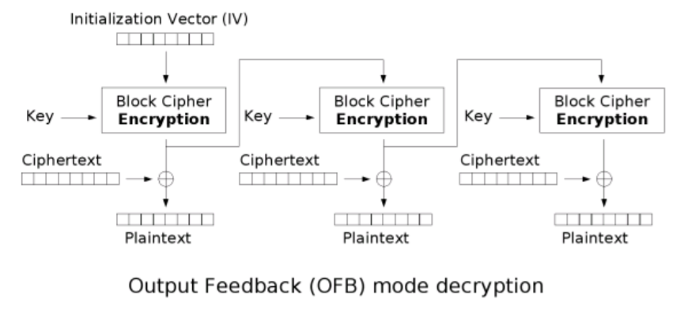
OFB Decryption

Slide 14
Advantages
The plaintext of the same word is not equivalent to the ciphertext with same representation.
Bit error in transmission will not propagate, error in one ciphertext block will only affect the current block's plaintext.
Encryption in the blocks are independent from the data which helps with the protection of the key.

Slide 15
Disadvantages
It is unable to perform parallel operations.
the sender and receiver must be in sync during the process.
It is vulnerable to message stream modification attack.
The biggest drawback of OFB is that the repetition of encrypting the initialization vector may produce the same state that has occurred before. It is an unlikely situation but in such a case the plaintext will start to be encrypted by the same data as previously.

Slide 16
Secure channel
Is way of transferring data that is resistant to overhearing and tampering
But there are no perfectly secure channels in the real world. There are, at best, only ways to make insecure channels less insecure.

Slide 17

Key exchange
A method by which cryptographic keys are exchanged between two parties, allowing use of a cryptographic algorithm
Key exchange problem:
describes ways to exchange whatever keys or other information are needed for establishing a secure communication channel so that no one else can obtain a copy

Slide 18
Diffie–Hellman key exchange
DH is one of the earliest practical examples of public key exchange implemented within the field of cryptography
Published in 1976
Invented by Whitfield Diffie and Martin Hellman
The protocol enables users to securely exchange secret keys even if an opponent is monitoring that communication channel
It allows two parties that have no prior knowledge of each other to jointly establish a shared secret key over an insecure channel

Slide 19
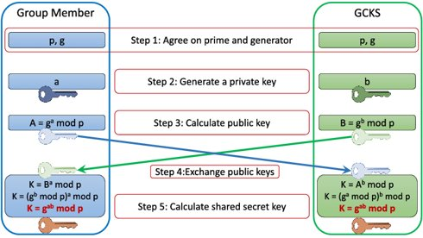
Process

Slide 20
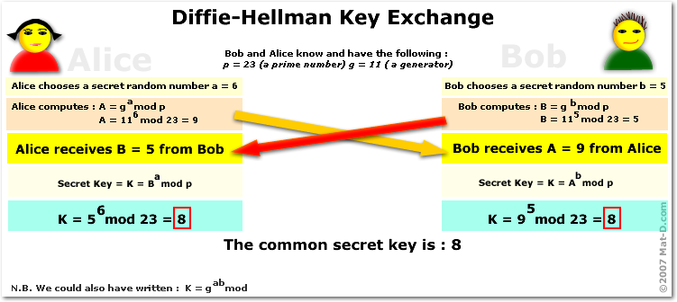
Example

Slide 21
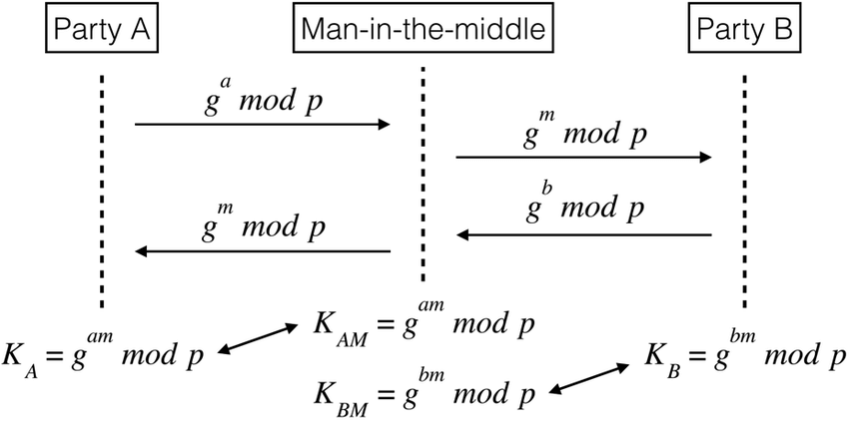
Vulnerability of D-H
The Diffie–Hellman exchange by itself does not provide authentication of the communicating parties and is thus vulnerable to a man-in-the-middle attack.

Slide 22
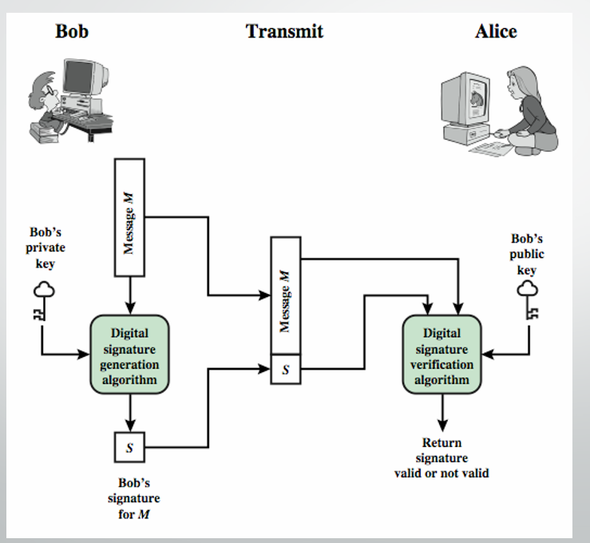
The digital signature

Slide 23
El-Gamal Signature
The algorithm was invented by Taher El-Gamal
El-Gamal has published in 1986 the idea of using a public key to create a digital signature
The idea was based on the problem of the discrete logarithm inspired by the work of Diffie-Hellman in 1976.
The signature's general idea:
Uses private key for encryption (signing)
Uses public key for decryption (verification)

Slide 24

The Key generation
The user generates a public key and a suitable private key as follows:
Choose a prime number P and generator g.
Choose a random integer 1< x <P-1.
Compute: A = g^{x} mod P.
We recognize Diffie-Hellman in the first three steps.
The public key is: (p , g ,A)
The private key is x.

Slide 25
The signing
Generate a random integer 1< K <p-1 while gcd(K,p-1)=1 .
Compute s1 = g^{k} mod p.
Compute K⁻¹ mod (p-1).
Compute s2 = K⁻¹ (H(m)-x*s1) mod (p-1) ,0<=H(m)<=(p-1)
Signature is: DS=(s1,s2).

Slide 26

The verification algorithm
After the other party receive the message with the signature, he wants to verify.
The signature verification process is done with the public key (p , g ,A) of the sender:
Compute V₁ = g^{H(m)} mod p.
Compute V₂ = A^{s1} s1^{s2} mod p.
Signature is valid if V₁ = V_{2.}

Slide 27

Security
If an attacker tries to change the K, he need to compute :
s2 = K⁻¹ (H(m)-x*s1) mod (p-1)
This problem is equivalent to the problem of the discrete logarithm which is a difficult mathematical problem.

Slide 28


